Slide 1

Application of chemometric methods to predict the toxicity of xenoestrogens and microplastic towards embryos of the Danio rerio species
Adrianna Gabryś

Slide 2





Introduction
XENOESTROGENS
IMITATE ESTROGEN
BIOACCUMULATE IN THE ENVIRONMENT
VARIOUS LEVEL OF MODIFICATION
SOURCES INCLUDE:
  Plastics
  Pesticides
  Tap Water
  Cosmetics, lotions, shampoos

Slide 3



Introduction
MICROPLASTIC
PLASTIC LESS THAN 5MM IN LENGTH
BIOACCUMULATE IN THE ENVIRONMENT
CAN ABSORB TOXIC CHEMICALS
SOURCES INCLUDE:
  Engineered plastic pellets
  Synthetic textiles
  Personal Care Products

Slide 4
Research methods
DATA PREPARATION
Data from 63 articles
43 different compounds
Table data variables for analysis:
No. | Compound No. | Compound name | Docking to D.rerio ERα | Docking to D.rerio ERRγA | Docking to D.rerio ERRγB | LogP | Concentration [mg/L] | Ethanol concentration | DMSO concentration | Mortality control | Mortality 24h
1 | 1 | bisphenol A | 5.0720 | 3.2700 | 5.5700 | 4.3400 | 0.0001 | 0.0000 | 0.0001 | 0.0000 | 0.0000
2 | 1 | bisphenol A | 5.0720 | 3.2700 | 5.5700 | 4.3400 | 0.0010 | 0.0000 | 0.0001 | 0.0000 | 0.0000
3 | 1 | bisphenol A | 5.0720 | 3.2700 | 5.5700 | 4.3400 | 0.0100 | 0.0000 | 0.0001 | 0.0000 | 0.0000
4 | 1 | bisphenol A | 5.0720 | 3.2700 | 5.5700 | 4.3400 | 0.1000 | 0.0000 | 0.0001 | 0.0000 | 0.0000
5 | 1 | bisphenol A | 5.0720 | 3.2700 | 5.5700 | 4.3400 | 0.5000 | 0.0000 | 0.0050 | 0.1000 | 0.0000
6 | 1 | bisphenol A | 5.0720 | 3.2700 | 5.5700 | 4.3400 | 1.0000 | 0.0000 | 0.0050 | 0.1000 | 0.0000
7 | 1 | bisphenol A | 5.0720 | 3.2700 | 5.5700 | 4.3400 | 1.1400 | 0.0000 | 0.0010 | 0.0000 | 0.0000
8 | 1 | bisphenol A | 5.0720 | 3.2700 | 5.5700 | 4.3400 | 1.5000 | 0.0000 | 0.0050 | 0.1000 | 0.0000
        Docking to D.rerio ERα, ERRγA, ERRγB
        LogP
        Concentration
    Solvents concentrations
    Mortality control
    Mortality after 24h
Fig. 1. Fragment of experimental data table with variables (number of sample, compound number, compound name, docking to D.rerio ERα, ERRγA, ERRγB, LogP, concentration, ethanol concentration, DMSO concentration, mortality control and mortality after 24h)

Slide 5
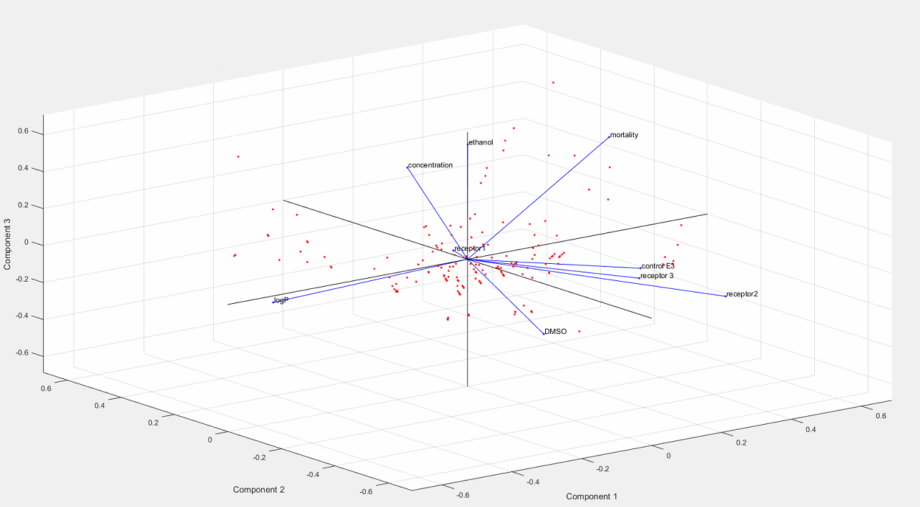
Research methods
Principal Component Analysis (PCA)
  Visualization of multidimensional data
  Reduction of the dimensionality of the problem
Fig. 2. Biplot representing samples, variables (docking to D.rerio receptors, LogP, concentration, ethanol concentration, DMSO concentration, mortality control and mortality after 24h) and dependencies between variables - PCA analysis

Slide 6
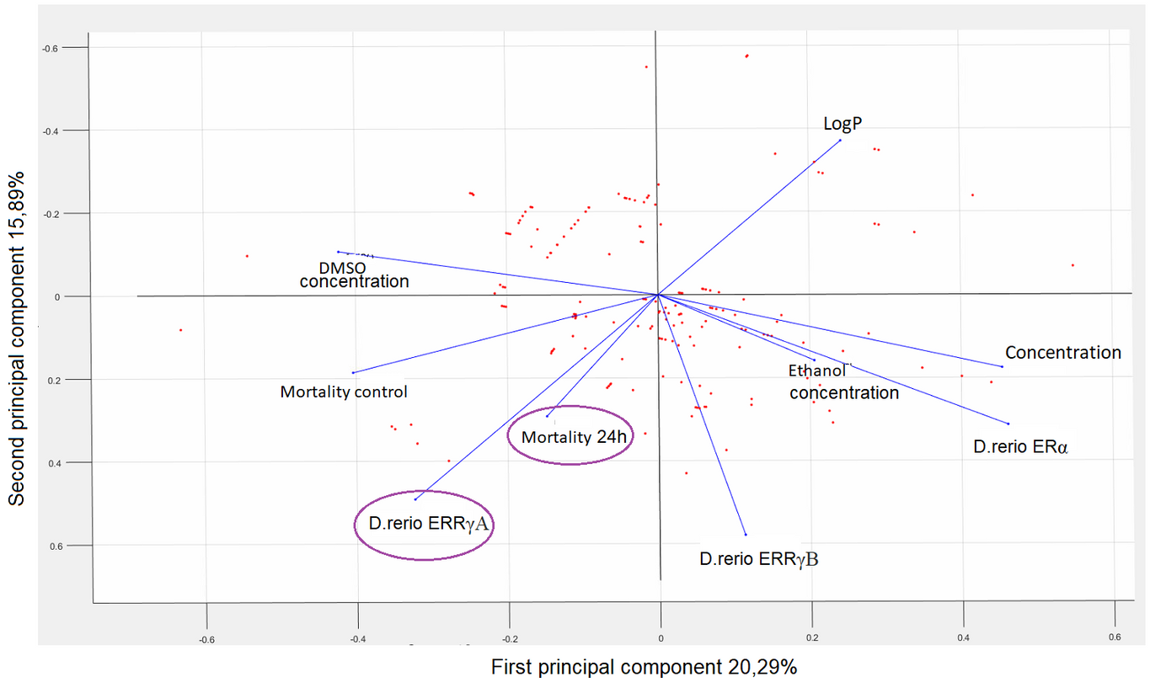
Results
PCA RESULTS
No. | Docking to D.rerio ERα | Docking to D.rerio ERRγA | Docking to D.rerio ERRγB | LogP | Concentration [mg/L] | Ethanol concentration | DMSO concentration | Mortality control | Mortality 24h
1 | 5.0720 | 3.2700 | 5.5700 | 4.3400 | 0.0001 | 0.0000 | 0.0001 | 0.0000 | 0.0000
2 | 5.0720 | 3.2700 | 5.5700 | 4.3400 | 0.0010 | 0.0000 | 0.0001 | 0.0000 | 0.0000
3 | 5.0720 | 3.2700 | 5.5700 | 4.3400 | 0.0100 | 0.0000 | 0.0001 | 0.0000 | 0.0000
Fig. 3. Dimensional projection onto chart representing first and second principal component

Slide 7
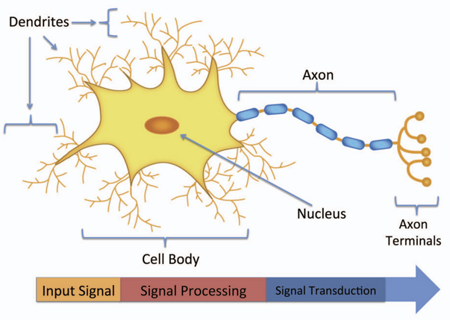
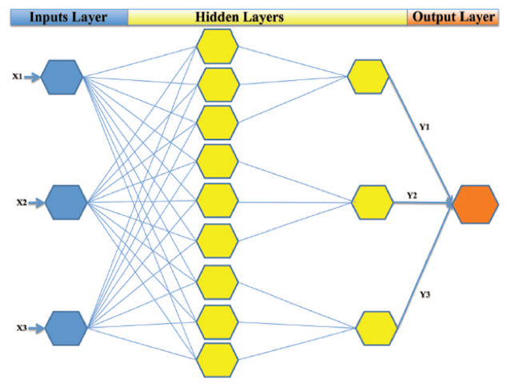
Research methods
ARTIFICIAL NEURAL NETWORK (ANN)
Biological neurons
Artificial Neural Networks
Fig.4. Conceptual structure of a biological neuron from article "Artificial Neural Network in Drug Delivery and Pharmaceutical Research"
Fig. 5. A schematic of four-layered artificial network from article "Artificial Neural Network in Drug Delivery and Pharmaceutical Research"

Slide 8
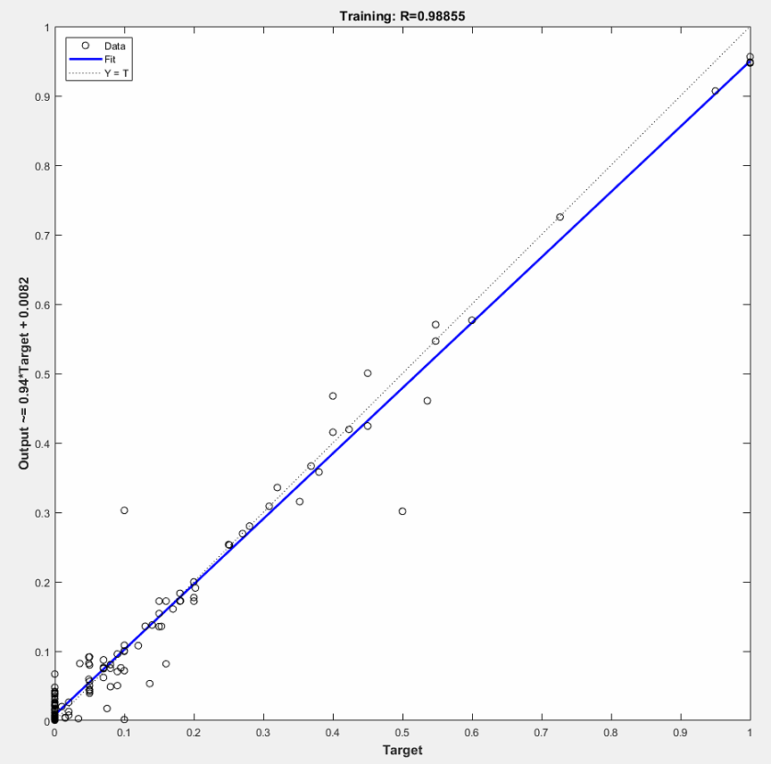
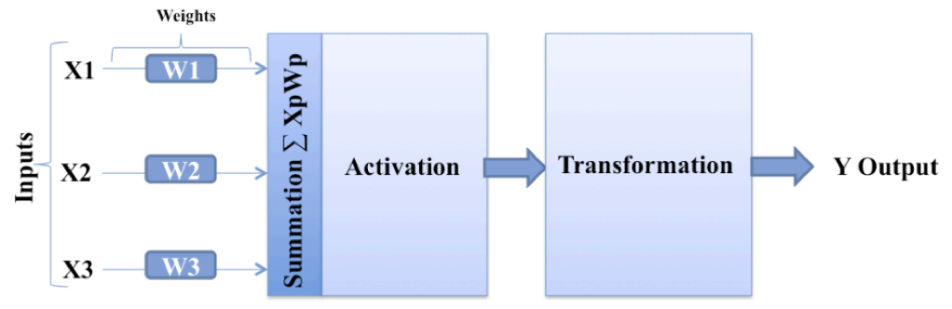
Research methods
CREATING NETWORK:
  NETWORK DESIGN
  TRAINING
  VALIDATION
  MAKE YOUR OWN PREDICTIONS
5.0720 | 3.2700 | 5.5700 | 4.3400 | 0.0001 | 0.0000 | 0.0001 | 0.0000 | 0.0000
5.0720 | 3.2700 | 5.5700 | 4.3400 | 0.0010 | 0.0000 | 0.0001 | 0.0000 | 0.0000
5.0720 | 3.2700 | 5.5700 | 4.3400 | 0.0100 | 0.0000 | 0.0001 | 0.0000 | 0.0000
5.0720 | 3.2700 | 5.5700 | 4.3400 | 0.1000 | 0.0000 | 0.0001 | 0.0000 | 0.0000
5.0720 | 3.2700 | 5.5700 | 4.3400 | 0.5000 | 0.0000 | 0.0050 | 0.1000 | 0.0000
5.0720 | 3.2700 | 5.5700 | 4.3400 | 1.0000 | 0.0000 | 0.0050 | 0.1000 | 0.0000
5.0720 | 3.2700 | 5.5700 | 4.3400 | 1.1400 | 0.0000 | 0.0010 | 0.0000 | 0.0000
5.0720 | 3.2700 | 5.5700 | 4.3400 | 1.5000 | 0.0000 | 0.0050 | 0.1000 | 0.0000
Fig. 6. A common design of a node in an artificial neural network from article "Artificial Neural Network in Drug Delivery and Pharmaceutical Research"

Slide 9
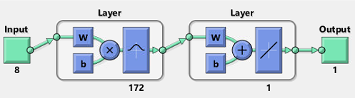
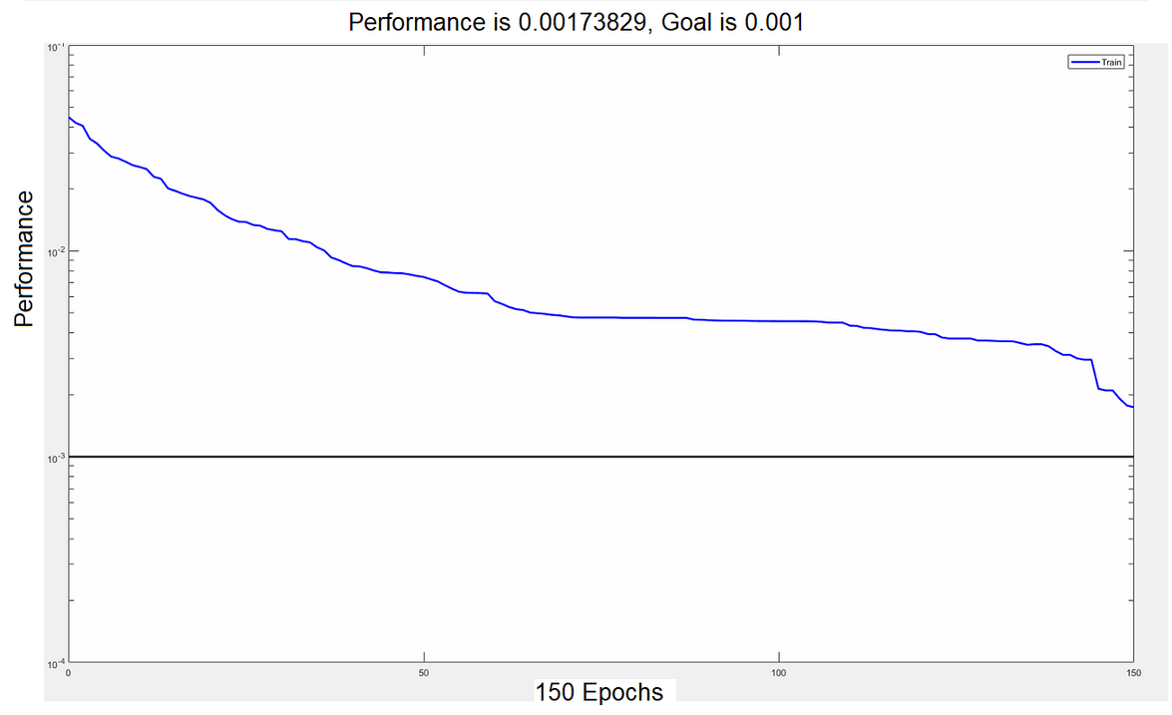
Research methods
RADIAL BASIS FUNCTION NETWORK
NETWORK DESIGN AND TRAINING
Fig. 7. The structure of the radial network used during training
Fig. 8. Learning process performance curve, X-axis - number of training epochs, Y-axis - performance of the network

Slide 10
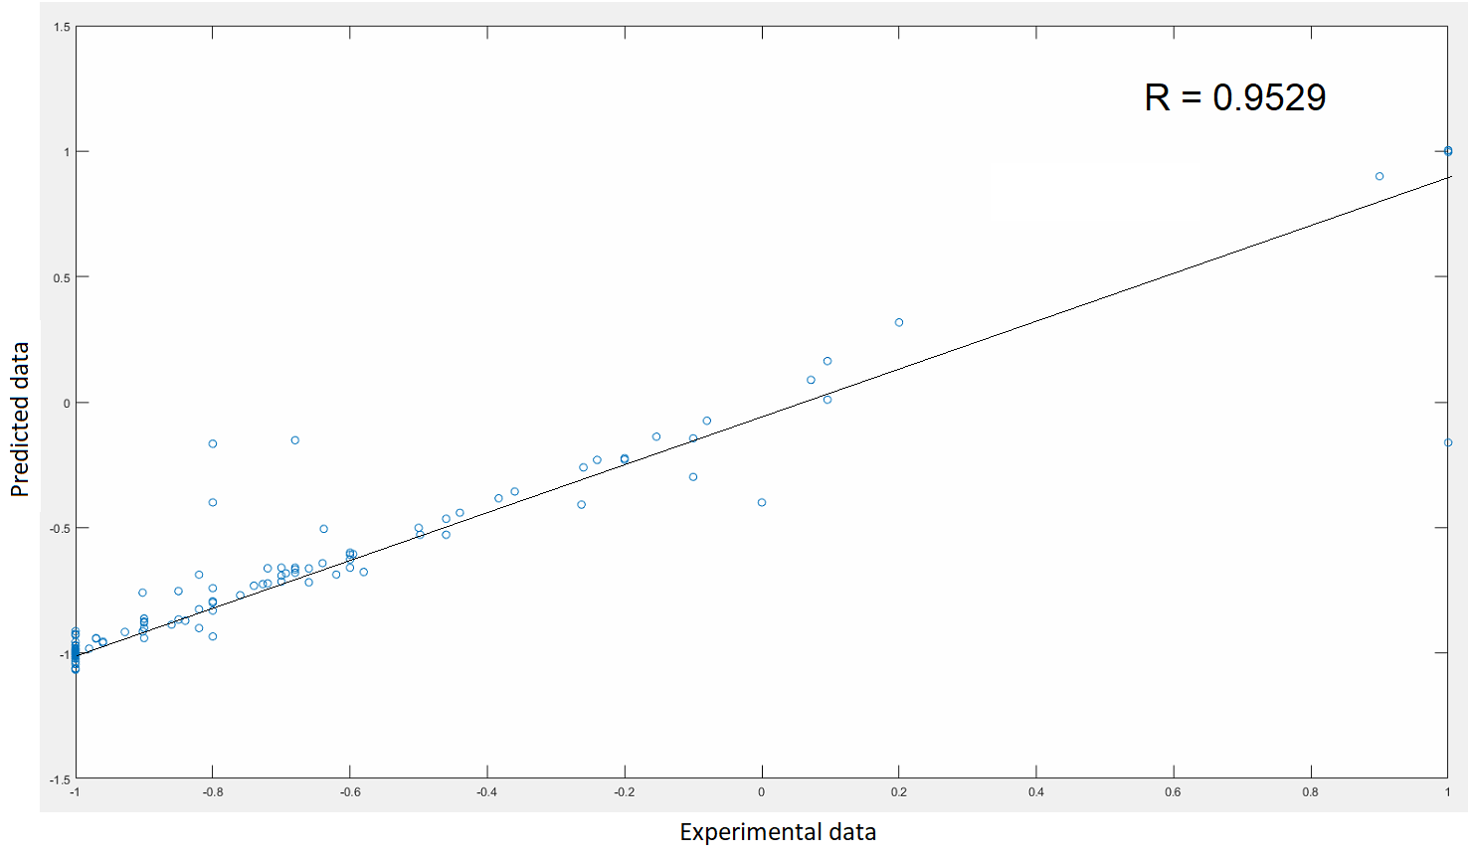
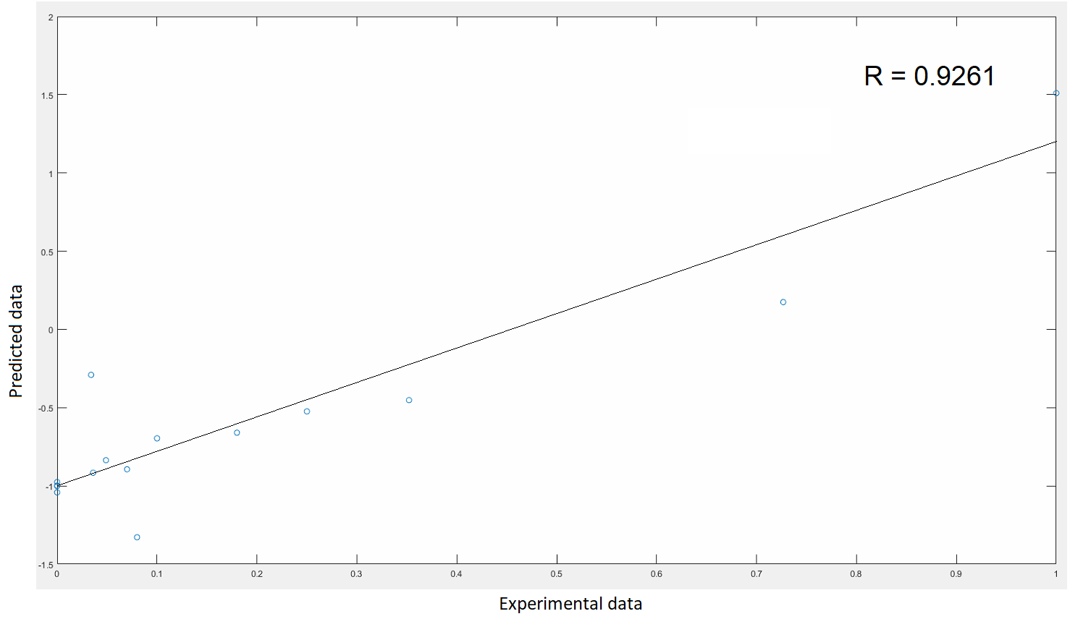
Research methods
TRAINING OUTPUT
VALIDATION OUTPUT
Fig. 9. Regression curve of the training data, Experimental data - known mortality of D. rerio embryos 24 hours after fertilization, Predicted data - data predicted by radial basis function network (R = 0.9529)
Fig. 10. Regression curve of the validation data, Experimental data - known mortality of D. rerio embryos 24 hours after fertilization, Predicted data - data predicted by the radial basis function network (R = 0.9261)

Slide 11
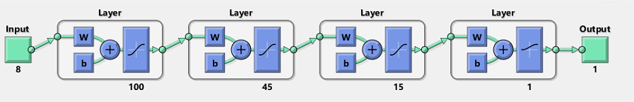
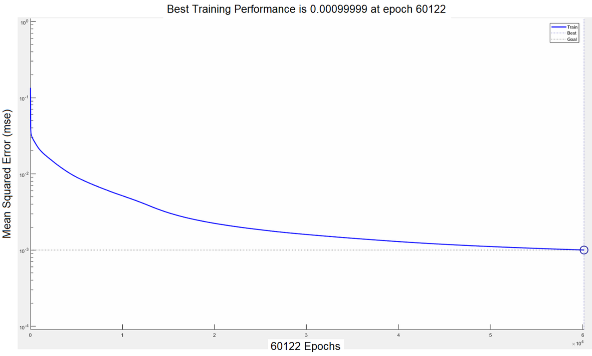
Research methods
FEED FORWARD NETWORK
NETWORK DESIGN AND TRAINING
Fig. 11. The structure of the feed forward network used during training
Fig. 12. Learning process performance curve, X-axis - number of training epochs, Y-axis - mean squared error of the network

Slide 12
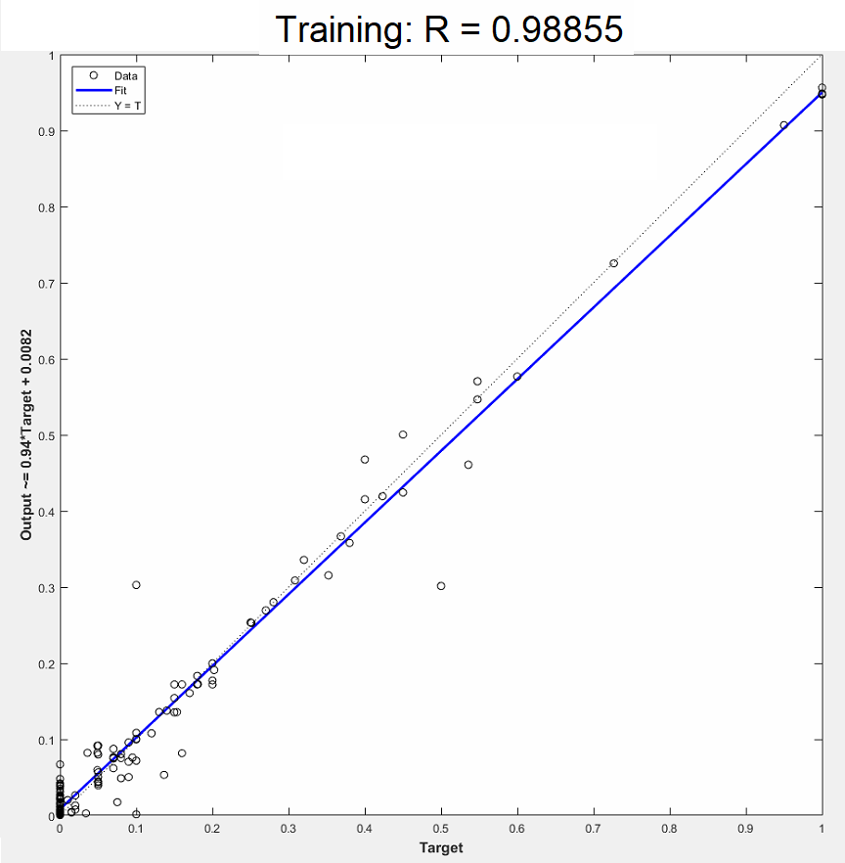
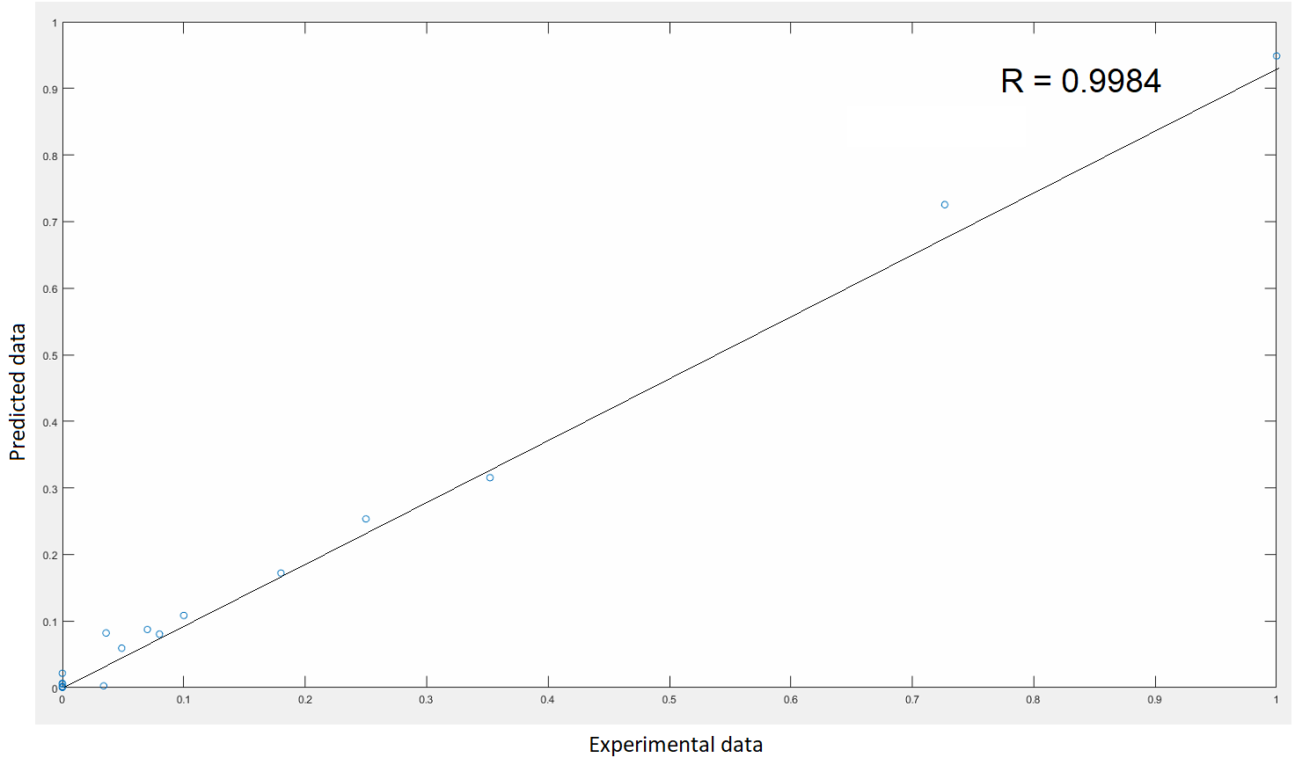
Research methods
TRAINING OUTPUT
VALIDATION OUTPUT
Fig. 13. Regression curve of the training data, Target - known mortality of D. rerio embryos 24 hours after fertilization, Output - data predicted by the feed forward network (R = 0.98855)
Fig. 14. Regression curve of the validation data, Experimental data - known mortality of D. rerio embryos 24 hours after fertilization, Predicted data - data predicted by the feed forward network (R = 0.9984)

Slide 13
Results
FEED FORWARD NETWORK RESULTS
BISPHENOL A PREDICTIONS
Fig. 15. Predicted mortality data of D. rerio at 24 hours post-fertilization (hpf) after exposure to bisphenol A, obtained using feed forward network (model 2, 3, 5, 6, 7, 8, 9)
Fig. 16. Predicted mortality data of D. rerio at 24 hours post-fertilization (hpf) after exposure to bisphenol A, obtained using feed forward network (model 8)

Slide 14
Results
PROPICONAZOLE AND BISPHENOL AF PREDICTIONS
  Mortality after 24h after exposure to:
  Propiconazole – 0% (0.00-0.59%)
  Bisphenol AF – 0% (0.01-0.74%)
Fig. 17. Predicted mortality data of D. rerio at 24 hours post-fertilization (hpf) after exposure to propiconazole, obtained using feed forward network (model 1, 2, 3, 4, 5, 6, 7, 8, 9)

Slide 15
Results
POLYVINYL CHLORIDE AND POLYPROPYLENE PREDICTIONS
  Mortality after 24h after exposure to:
  Polyvinyl chloride
  - bad predictions: model 2
  Polypropylene
  - bad predictions: model 1, 2, 5, 7
Fig. 18. Predicted mortality data of D. rerio at 24 hours post-fertilization (hpf) after exposure to PVP and PP, obtained using feed forward network (model 1, 2, 3, 4, 5, 6, 7, 8, 9)

Slide 16

Why is this important ?

